Slide 1



WORKSHOPS
27 February 2026
https://globalai.es/
#AgentCamp #GlobalAICommunity

Slide 2


28 Febrero 2026
09:00 AM – 18:00 PM CST
CEU San Pablo
Madrid, Spain
https://globalai.es/
#AgentCamp #GlobalAICommunity

Slide 3


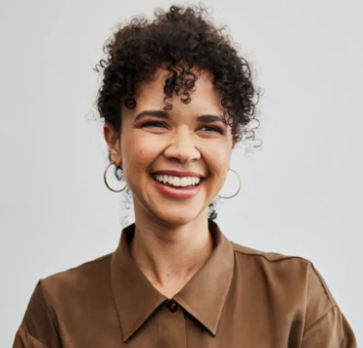
Increase your quality with the
power of Agentic Engineering
(Spec-Driven Development)
Tanya Smith
Sr. Software Engineer
#AgentCamp #GlobalAICommunity

Slide 4
Increase your quality with the
power of Agentic Engineering
Tanya Smith
Tanya Smith
Sr. Software Engineer
Sr. Software Engineer
#AgentCamp #GlobalAICommunity

Slide 5












¡Gracias a nuestros Patrocinadores!
PREMIUM
GOLD
Colaboradores:

Slide 6
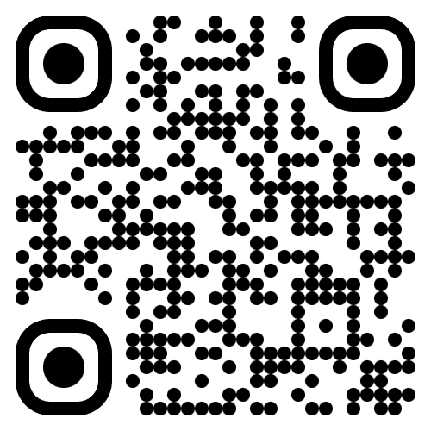
Join the AI Conversation on Discord
gaic.io/discord

Slide 7
Agenda

Slide 11
¡Gracias a nuestros Patrocinadores!
PREMIUM
GOLD
Colaboradores:

Slide 12
¡Gracias!
https://globalai.es/
#AgentCamp #GlobalAICommunity

